Slide 1


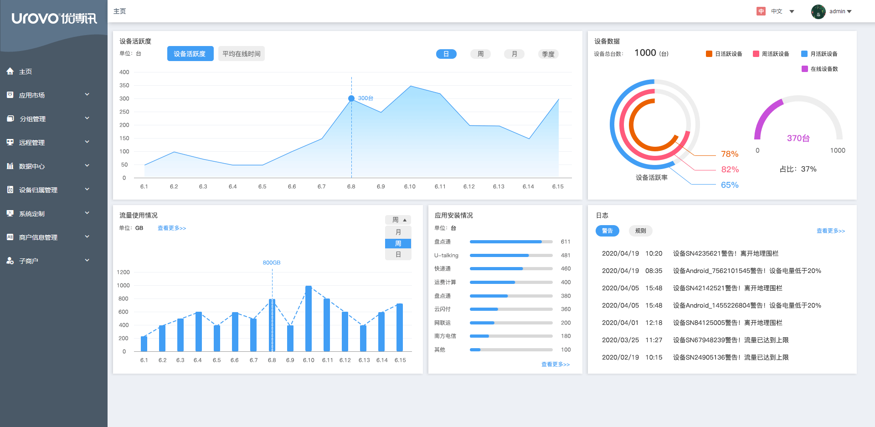
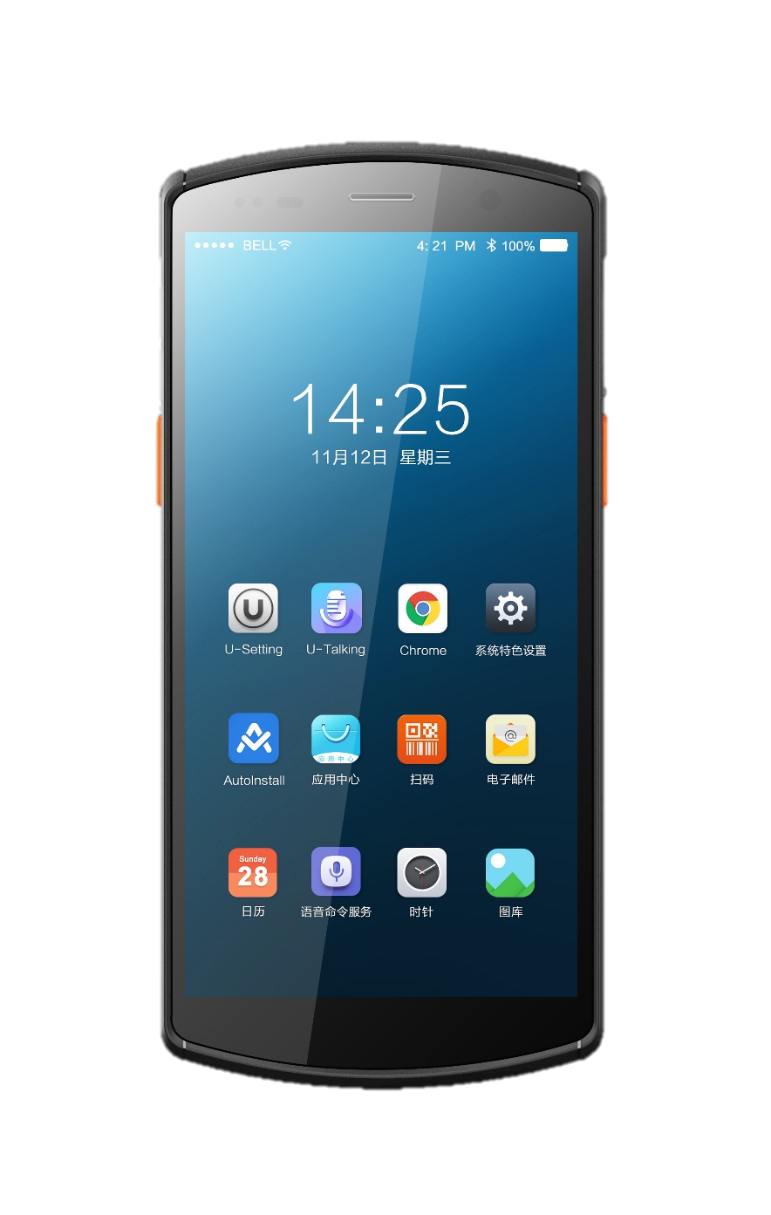
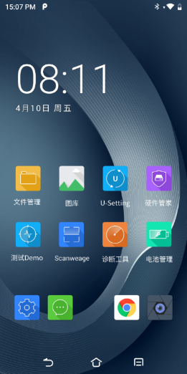
UMS
Unified Management System
All-in-one device management system

Slide 2
Contents
What is UMS?
Why we need UMS?
UMS function introduction

Slide 3
What is UMS？
UMS, or Unified Management System, is born for mobile smart terminals, which provides users with professional, efficient, safe and reliable remote management of equipment and applications, and is a one-stop platform connecting developers, agents and customers.

Slide 4
Full life cycle equipment management
From device registration to device recycling, UMS can realize the full process management for the full life cycle of devices,
helping enterprises provide one-stop deployment and management in the process of large-scale upgrade to digitization in the business process,
so as to save 90% human costs and time costs, greatly improving the operational efficiency of the enterprise.
Device Registration
Application Management
Device Management
Content Management
Remote Support
Device Recycling
Safety
*Device recycling does not necessarily mean the end of the cycle, it may also be the beginning of a new cycle. If a device is lost, it can be restored factory setting remotely to erase all data to prevent information leakage.

Slide 5
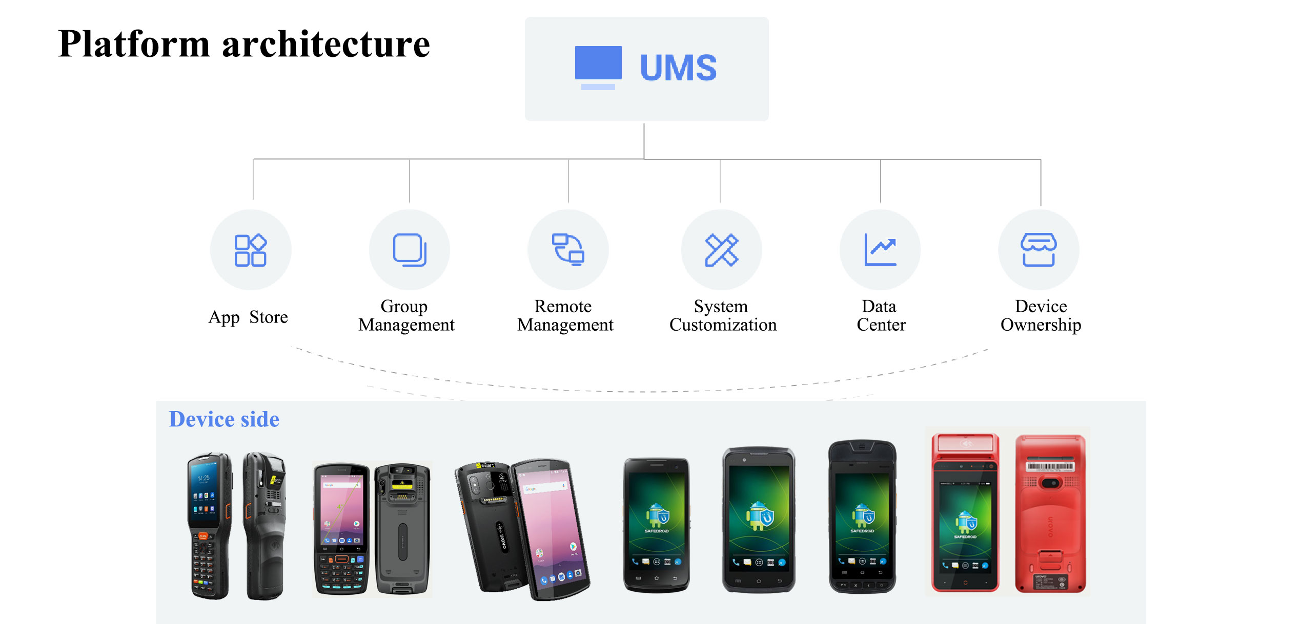

Slide 6
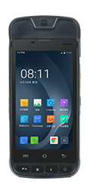
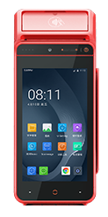


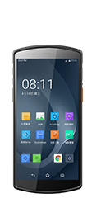
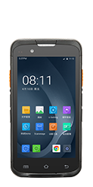
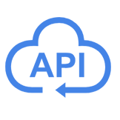
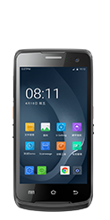
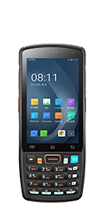


Optional deployment methods, safer, more efficient and more digital
Privatization deployment, all under control
We understand that enterprises attach importance to data confidentiality, so enterprises can choose to privatize their deployment and store the data in the intranet to ensure the privacy of the data.
Wireless data transmission
3G / 4G / 5G
Experience premium service for free
We hope you can feel our good intentions, so you can try our services for free. (Except for customized development by enterprise )
WiFi

Slide 7
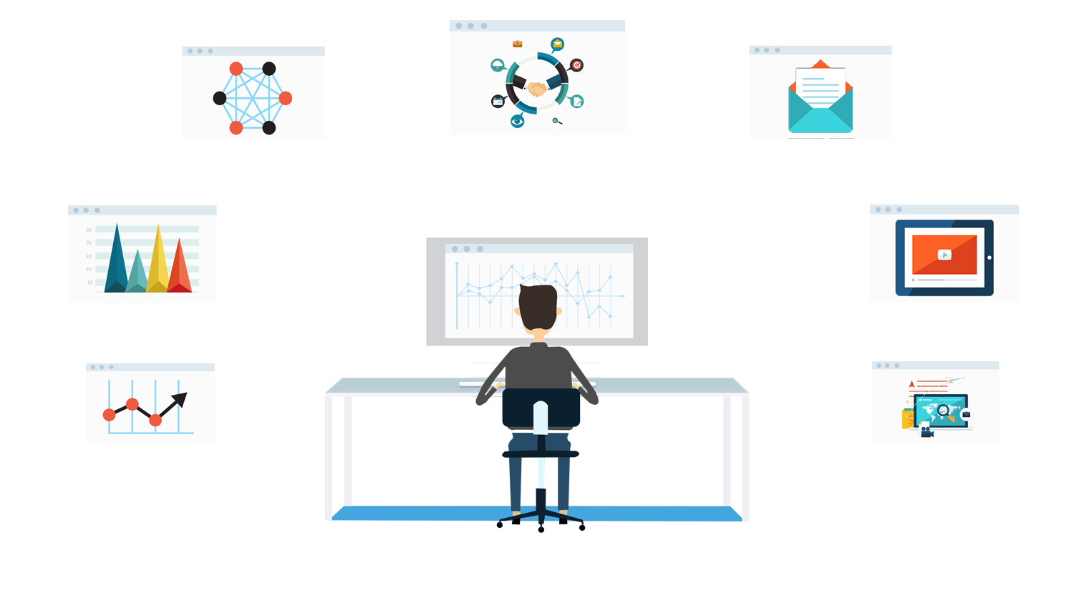
Why we need UMS?
When using the device, the device manager needs to set each device to the state required by the enterprise, manual adjustment is time-consuming and laborious.
UMS can help you complete this task more easily. You can remotely manage all terminal devices in batches, including viewing device information, location tracking, restricting the area of use, batch installation, updating and uninstalling applications, obtaining application logs and remote diagnosis, which will save 90% human and time costs, and greatly improve management efficiency.

Slide 8
Does mobile computer really solve your problem?
Deployment / Upgrade / Install
HUNDREDS DEVICE !!
Operator is PLAYING GAMES!
Use case always changing!
Confidential data is in LOST DEVICE !
Customer always want customize !
They mixed up different deployment !
I hope I can fly there…
……..
Tell me what application is most frequently used

Slide 9
Total UMS solution
All solution in single platform
Batch deployment, upgrade, installation
OS update reminding
Limited operator’s authority for download APK.
Manage different scenarios
……..
Realtime minute log and analysis
Encrypt all data in terminal
Remote monitor in cloud system
Analysis user operations data

Slide 10

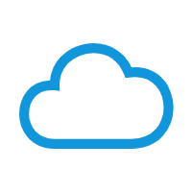
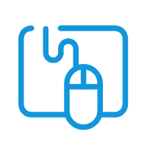

Our value
All in one, easy access
Powered by Alibaba cloud, safe and secure
Partner Connect，obtain most frequently used services, can manage all shop and device under your account.
The “Partner connect” is on Alibaba cloud sever. Bandwidth, security, accessibility is guaranteed.
As simple as it seems
Digital management，visual dashboard
“Partner Connect” designed with graphic web base user interface, friendly to use.
Real-time data analysis and remote monitor, provide information for decision making,

Slide 11
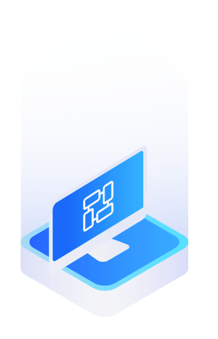


UMS function introduction
Just moving the mouse, you can comprehensively manage the device from three dimensions of mobile application management, mobile device management and mobile content management.
Mobile Application Management
(MAM)
Mobile Devices Management
(MDM)
Mobile Content Management
(MCM)

Slide 12
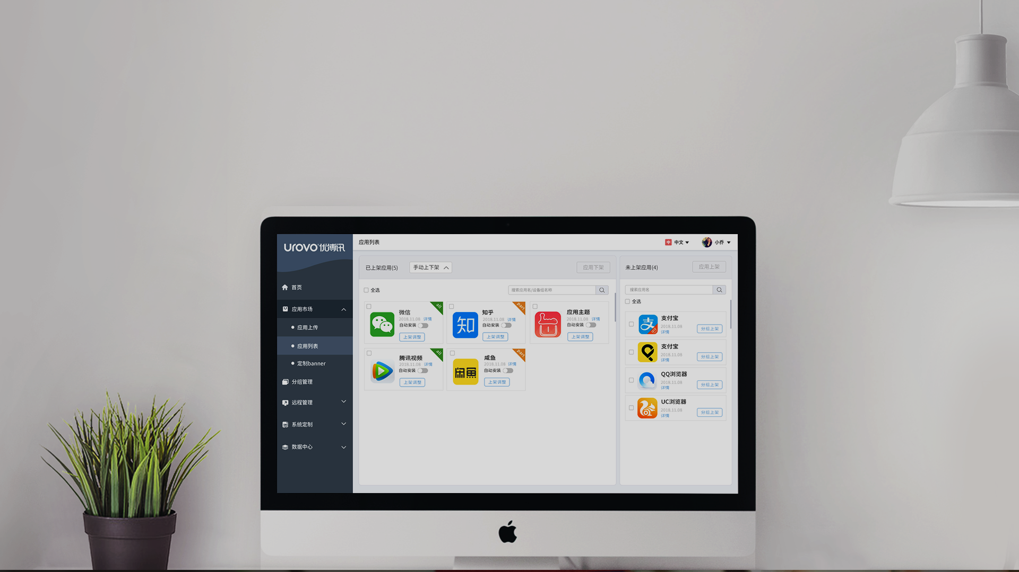

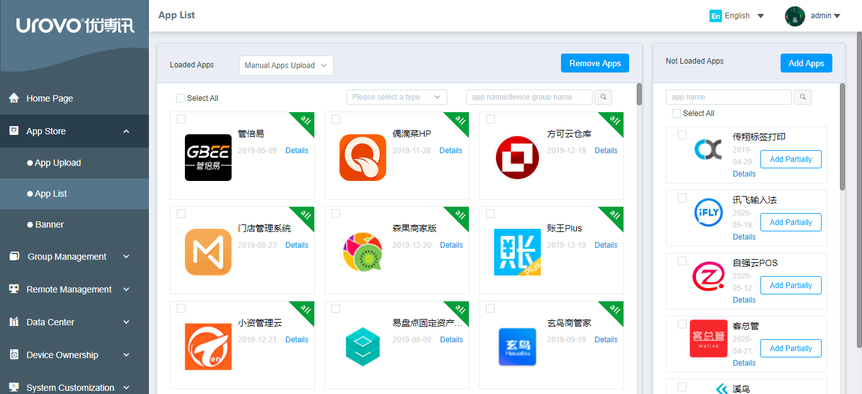
Mobile Application Management (MAM)
Application Market
Silent Installation
Application Information
Blacklist & Whitelist
Kiosk Mode
Black-start
Developers can add and remove apps from the application market and deploy flexibly; managers can select appropriate applications and deliver them to devices in batches

Slide 13
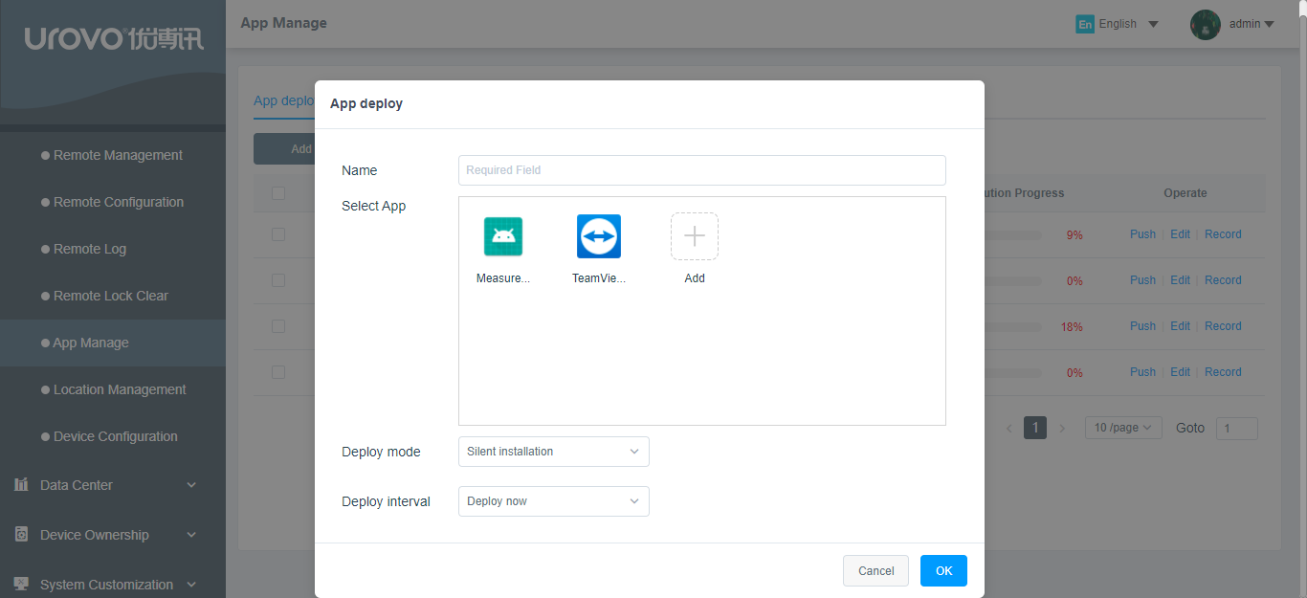
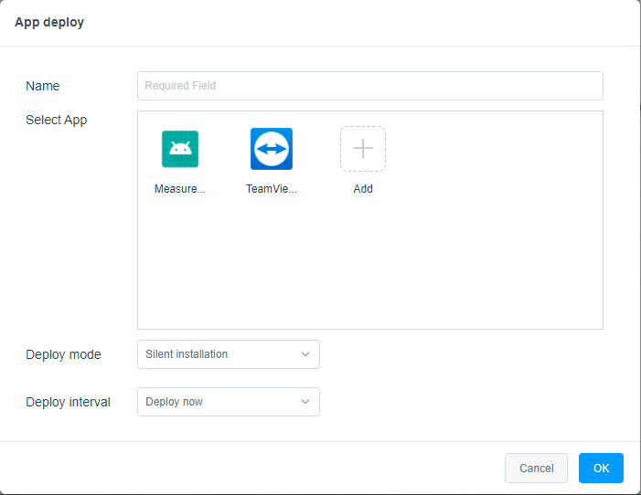
Mobile Application Management (MAM)
Application Market
Silent Installation
Application Information
Blacklist & Whitelist
Kiosk Mode
Black-start
The administrator can delivery applications to the device and install automatically without the consent of the device user

Slide 14
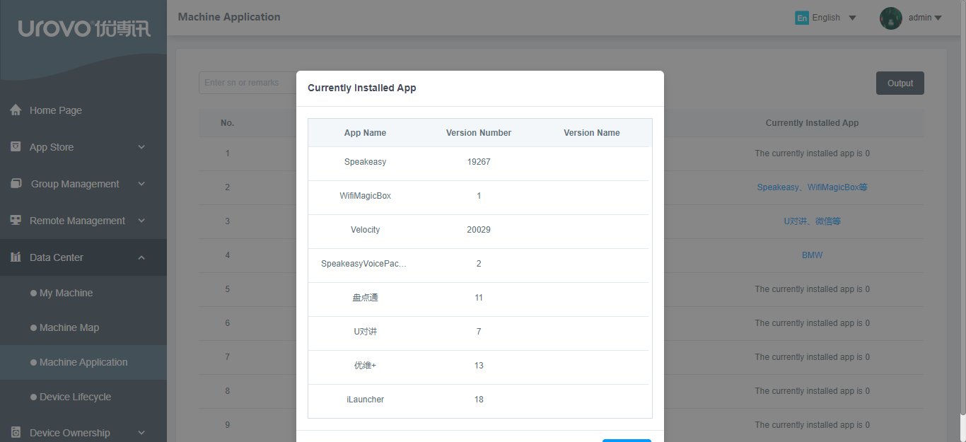
Mobile Application Management (MAM)
Application Market
Silent Installation
Application Information
Blacklist & Whitelist
Kiosk Mode
Black-start
The application information of the device terminals is fed back to the data center, and the administrator can query and trace back at any time.

Slide 15
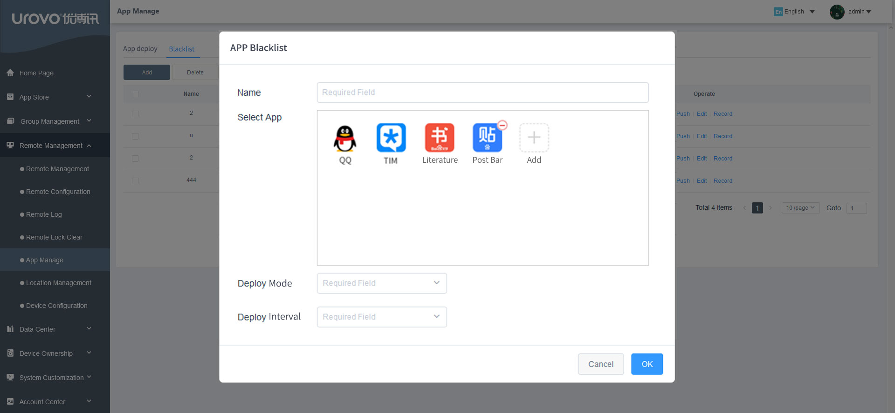
Mobile Application Management (MAM)
Application Market
Silent Installation
Application Information
Blacklist & Whitelist
Kiosk Mode
Black-start
Only whitelisted apps are allowed to be installed; blacklisted apps cannot be installed

Slide 16
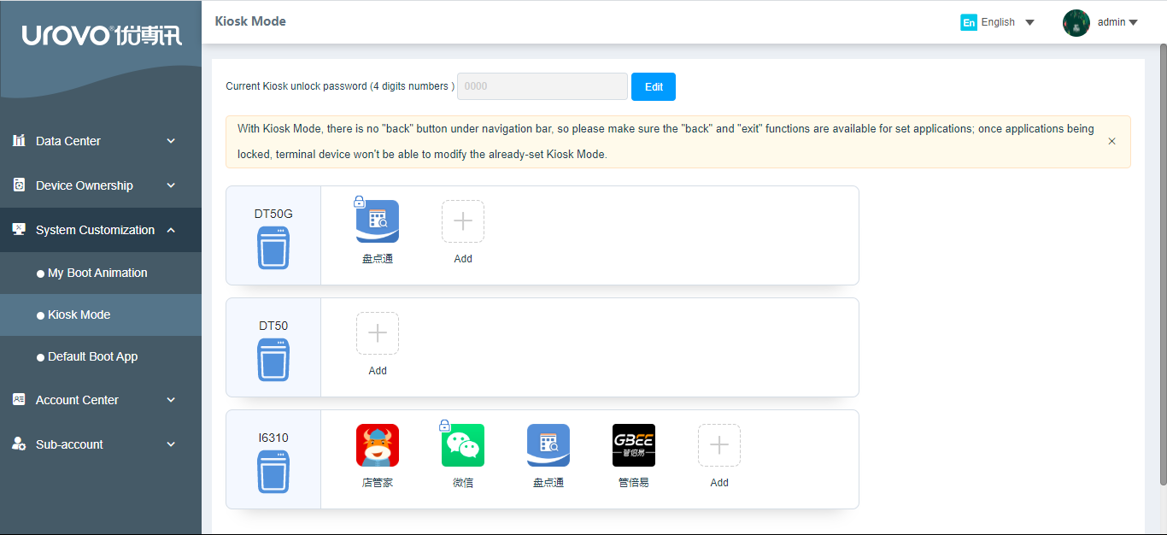
Mobile Application Management (MAM)
Application Market
Silent Installation
Application Information
Blacklist & Whitelist
Kiosk Mode
Black-start
The device will always display the domineering application, no one else can log out without authorization, ensuring that the working device is always in working condition

Slide 17
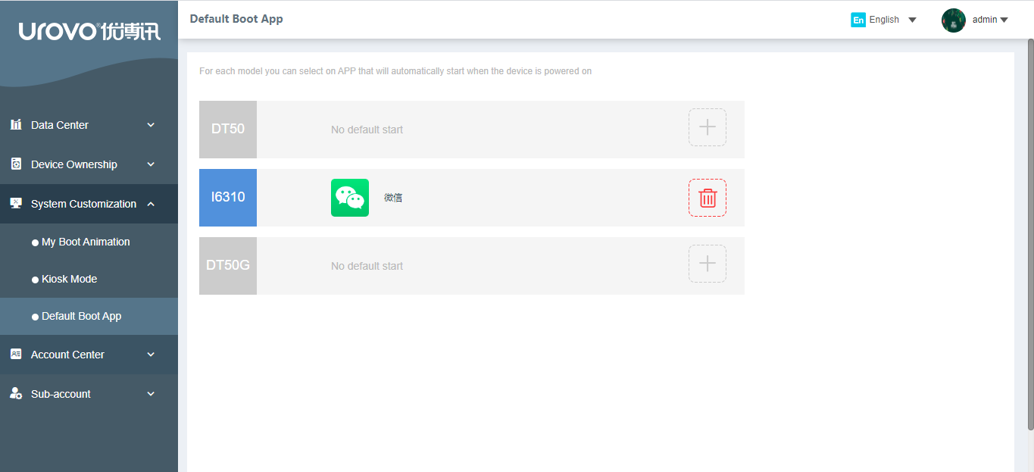
Mobile Application Management (MAM)
Application Market
Silent Installation
Application Information
Blacklist & Whitelist
Kiosk Mode
Black-start
When this function is turned on, the application will start automatically when the device is turned on

Slide 18

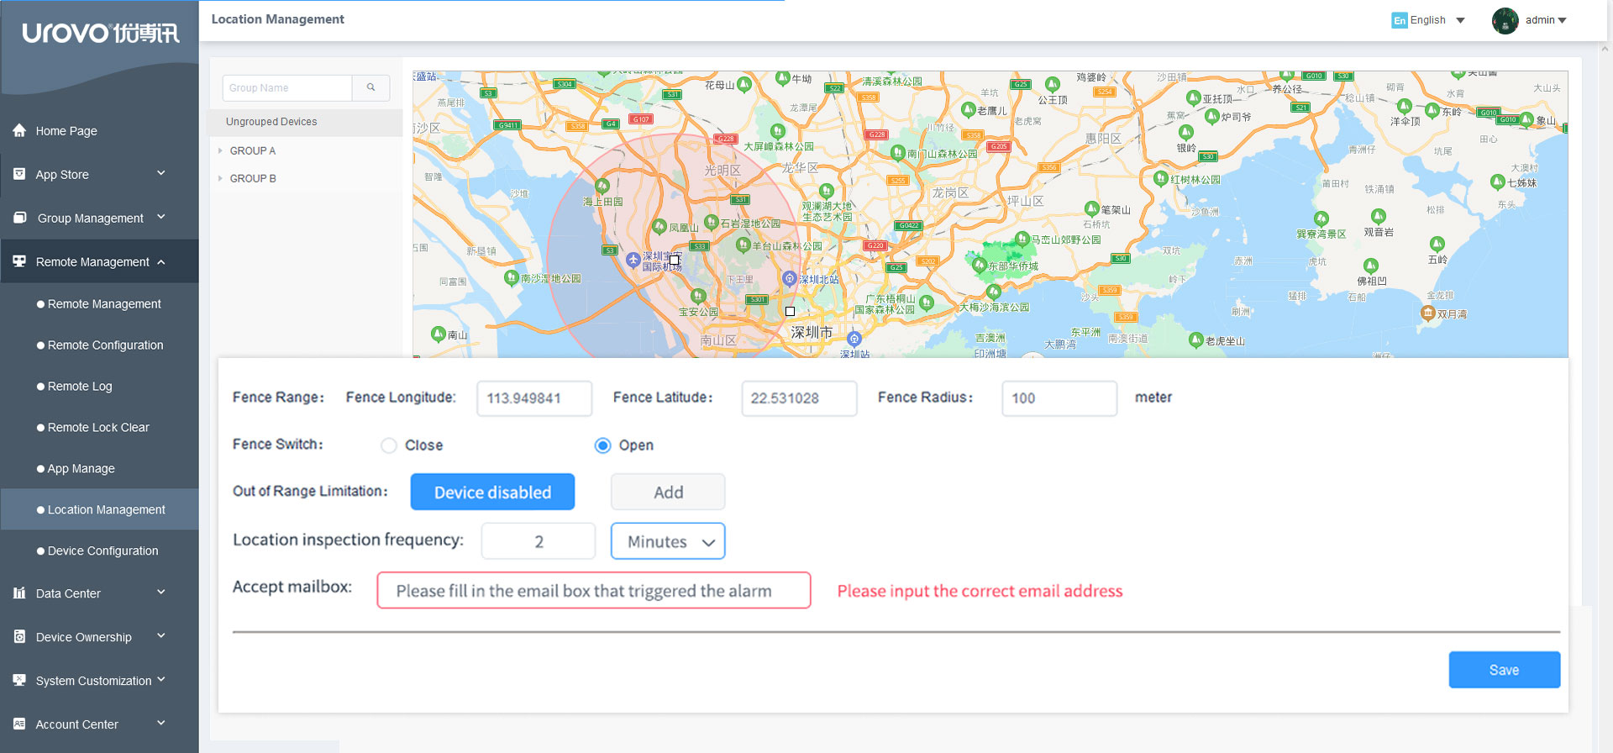
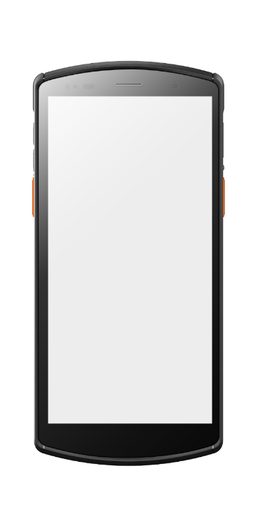
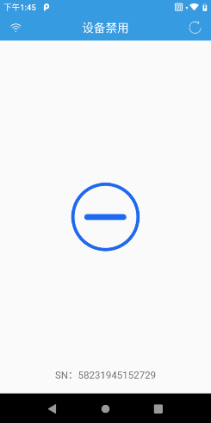
Mobile Device Management (MDM)
Geographical Fence
Android Permission Control
WiFi/APN Push
Remote Desktop
System Customization
Custom Desktop
WIFI Whitelist
Restrict the range of device usage. Once it is out of range, it can be disabled, and an alarm will be sent to the specified mailbox.

Slide 19
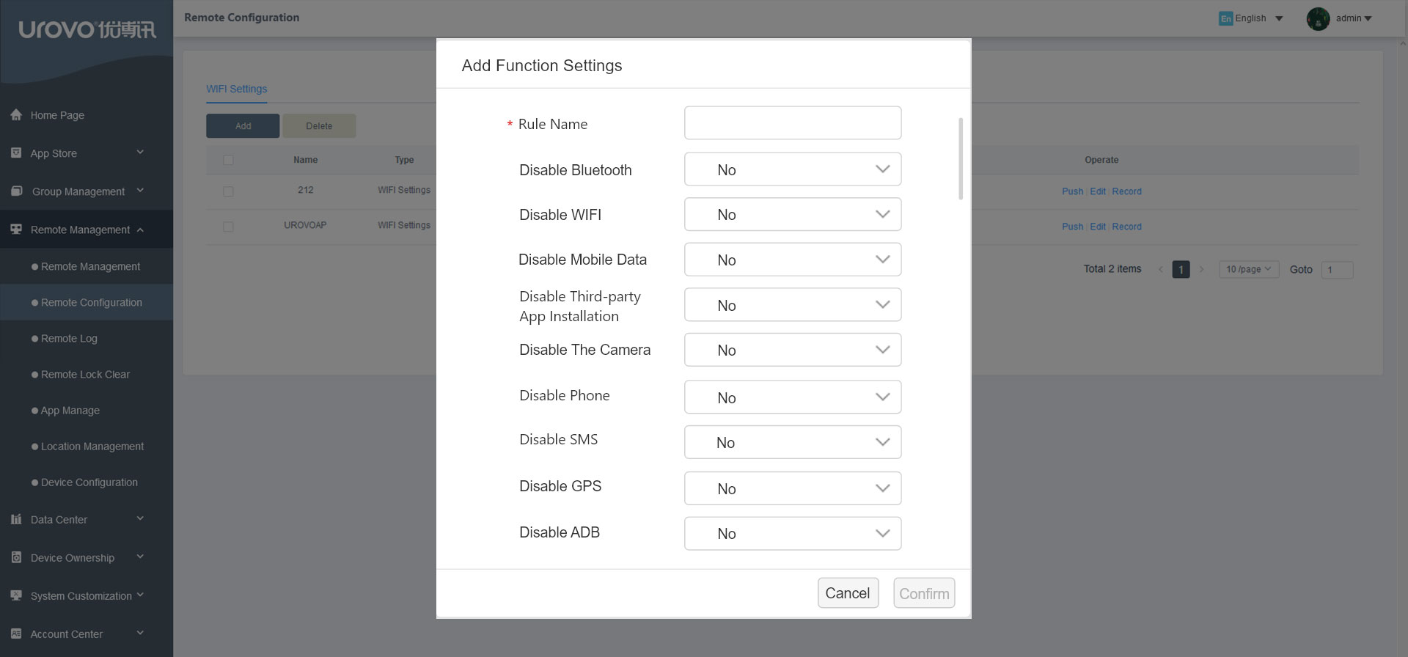
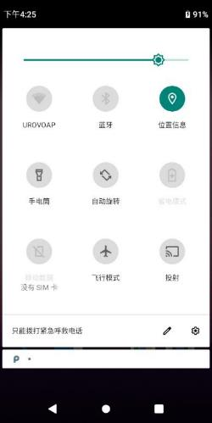
Mobile Device Management (MDM)
Geographical Fence
Android Permission Control
WiFi/APN Push
Remote Desktop
System Customization
Custom Desktop
WIFI Whitelist
Set to disable WiFi, Bluetooth, phone, data traffic, etc.

Slide 20
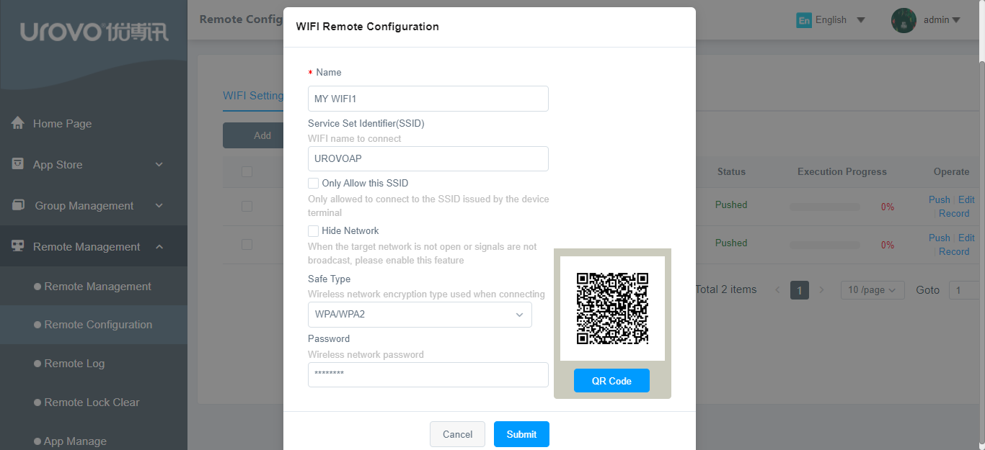
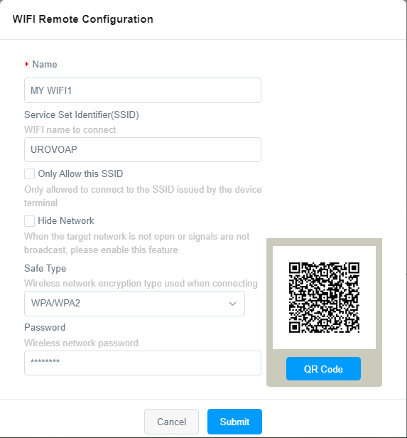
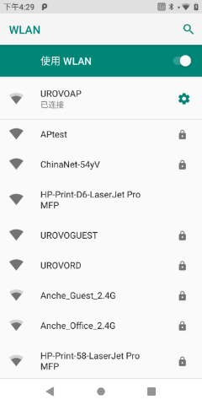
Mobile Device Management (MDM)
Geographical Fence
Android Permission Control
WiFi/APN Push
Remote Desktop
System Customization
Custom Desktop
WIFI Whitelist
Through the platform, deploy WiFi throughout the enterprise and configue operators by one click

Slide 21
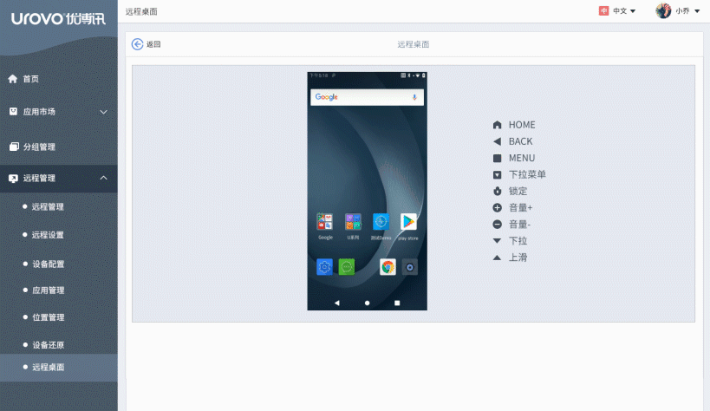
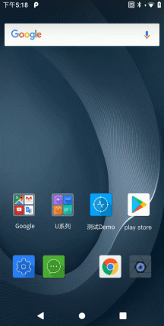
Mobile Device Management (MDM)
Geographical Fence
Android Permission Control
WiFi/APN Push
Remote Desktop
System Customization
Custom Desktop
WIFI Whitelist
Enterprises can achieve technical support through platform remote guidance and operation of device

Slide 22
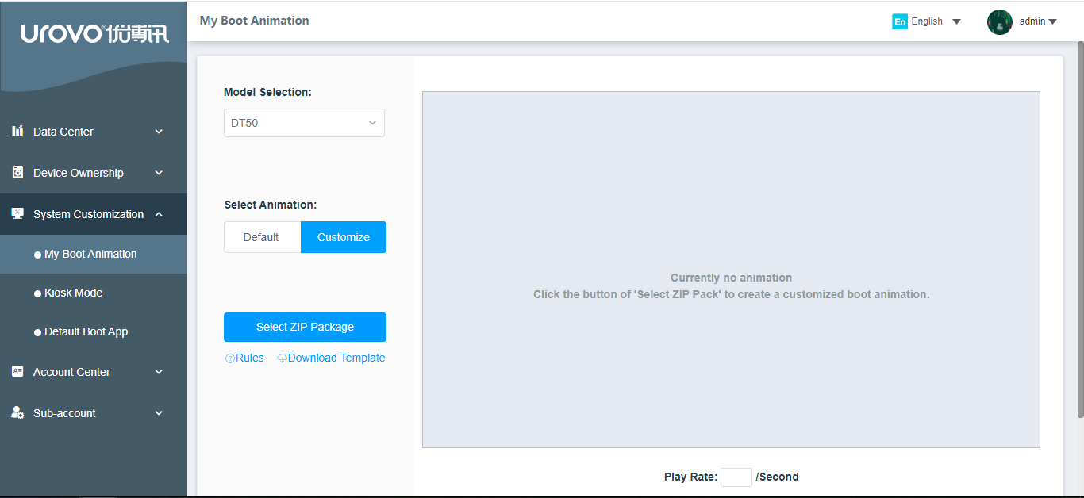

Mobile Device Management (MDM)
Geographical Fence
Android Permission Control
WiFi/APN Push
Remote Desktop
System Customization
Custom Desktop
WIFI Whitelist
The administrator can set up brand-specific boot animations, wallpapers and custom desktops to keep the consistency of device and corporate brand style.

Slide 23
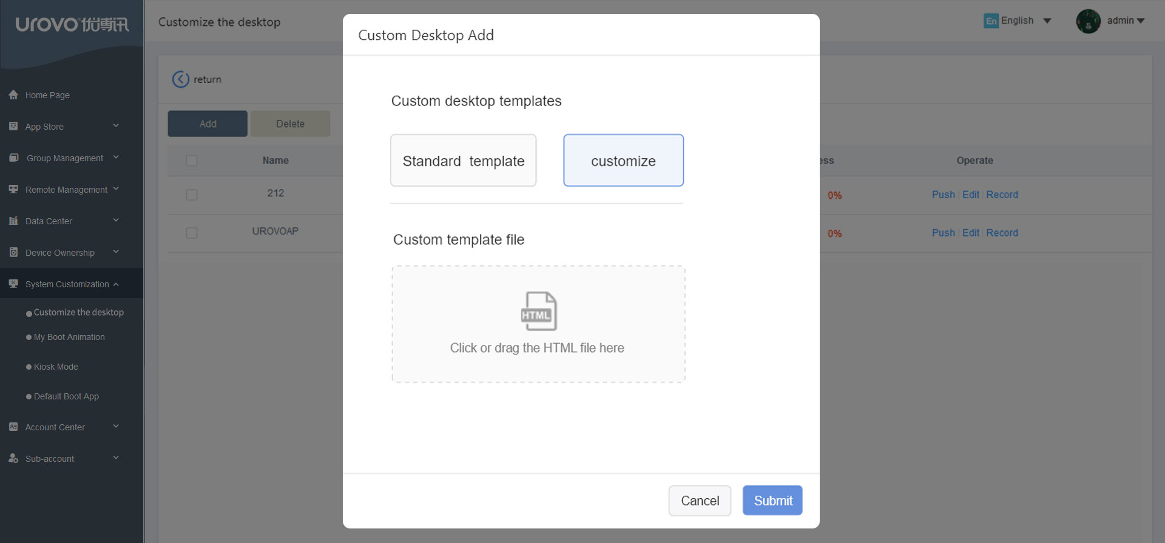
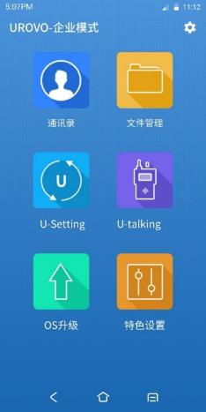
Mobile Device Management (MDM)
Geographical Fence
Android Permission Control
WiFi/APN Push
Remote Desktop
System Customization
Custom Desktop
WIFI Whitelist
Concise corporate desktop, restrict access to programs and settings on the device, can be restricted to one or more designated applications.

Slide 24
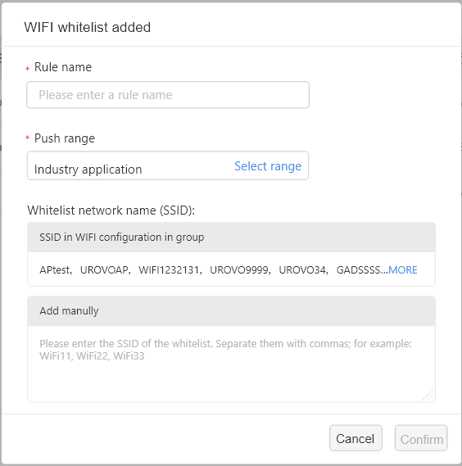
Mobile Device Management (MDM)
Geographical Fence
Android Permission Control
WiFi/APN Push
Remote Desktop
System Customization
Custom Desktop
WIFI Whitelist
Ensure that the device can only be connected to the WiFi in the whitelist, so as to effectively prevent malicious attacks and ensure safe and reliable corporate data.

Slide 25
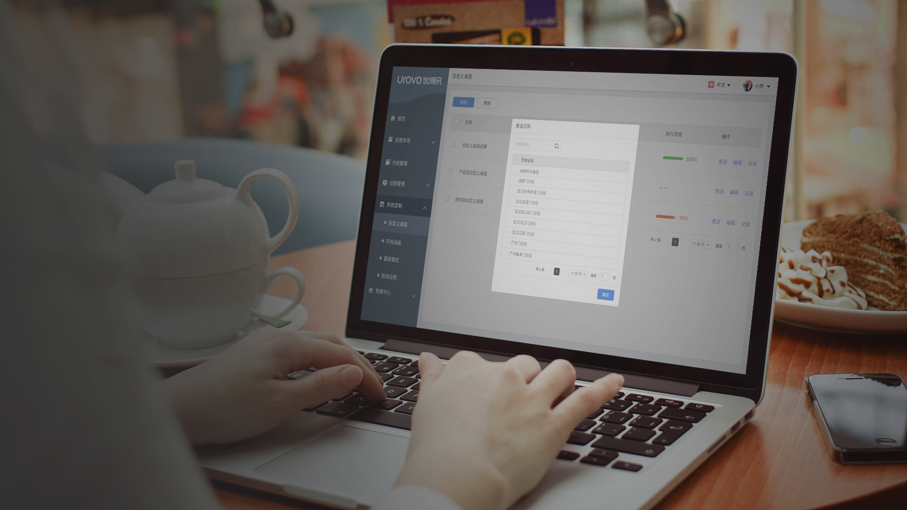




Mobile Content Management (MCM)
Data security
High-security encrypted transmission is applied from the mobile end to the cloud end to prevent data from being stolen maliciously, and to ensure that important information is protected well.
Remote data clearing
In the event that the device is lost or broken, the administrator can remotely erase data and restore factory settings so as to avoid leakage of corporate resources
Enterprise document distribution
Quickly distribute files to devices with one click
Enterprise news push
Push information with one click, convenient and fast

Slide 26


Secure Encryption Protocol
Adopt TLS/SSL encryption protocol to ensure the entire process of information transmission from mobile end to cloud end encrypted, so as to prevent data from being maliciously stolen
Strong Data Protection
Cloud data is backed up every 24 hours, and data within 24 hours can be restored through logs to ensure that each piece of data is guaranteed.
Strong System Stability
Through the HighAvailability technology, the cloud service guarantees the risk of server downtime caused by single-node failure and sudden system crashes (unplanned), so as to ensure that the server is protected during operation.

Slide 27
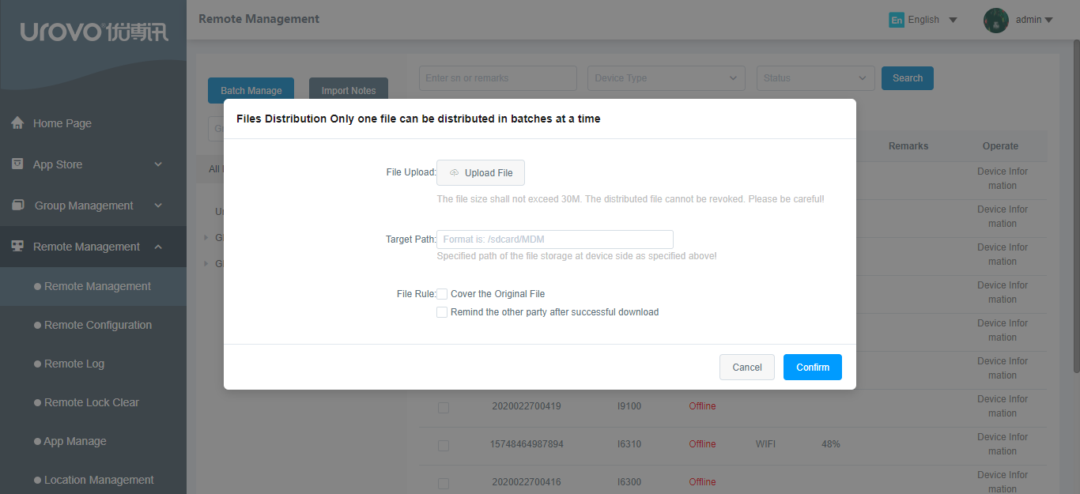
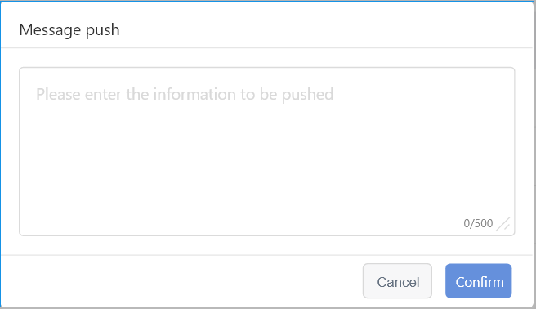
Mobile Content Management (MCM)
Corporate Information Push
Corporate Files Distribution
Remote Data Clearing
Push information with one click, which is convenient and fast

Slide 28
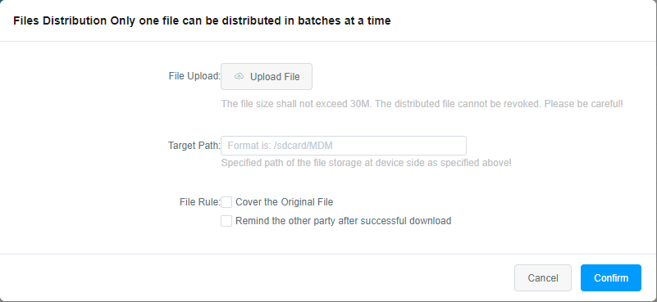
Mobile Content Management (MCM)
Corporate Information Push
Corporate Files Distribution
Remote Data Clearing
Distribute files to devices quickly with one click

Slide 29
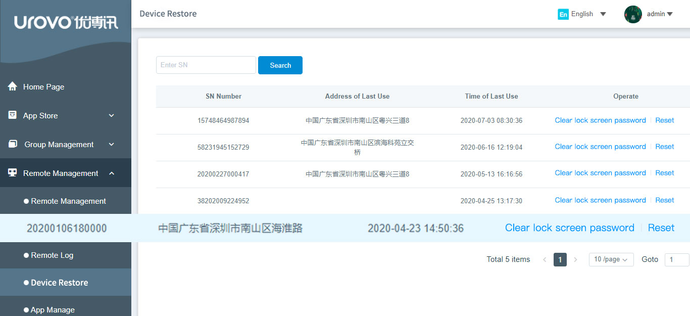
Mobile Content Management (MCM)
Corporate Information Push
Corporate Files Distribution
Remote Data Clearing
In case of lost of device or end of life cycle, the platform has powerful administrator authorities to remotely erase data and restore factory

Slide 30
UMS, Your Ultimate Mobility Solution

